Slide 1
Monday 22nd February 2021
Good Morning Enid Blyton and Jaqueline Wilson Class
9.30-10.30
Reading
11.00-12.00
Maths
1.00-2.00
English

Slide 2
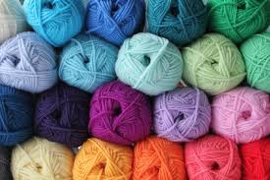
Reading/Writing
LI: To make inferences from descriptive language
Today we will be starting to look at a new book called ‘Extra Yarn’.
Before we begin, let’s have a conversation about yarn.
What is it?
Where does it come from?
What do we use it for?
What do we think the story ‘Extra Yarn’ might be about?

Slide 3
Reading/Writing
LI: To make inferences from descriptive language
I am going to read this sentence out loud. Whilst I do, I would like you to close your eyes and use your minds eye to create a picture in your head.
On a cold afternoon, in a cold little town, where everywhere you looked was either the white of snow or the black of soot from chimneys, Annabelle found a box filled with yarn of every colour.
Lets share and describe what images you visualised when this sentence was read aloud.
Were there any words that were hard to picture?
Now draw what you visualised. The quality of the drawing is not important your ideas are.
Lets share our drawings. Did you see things in a similar way?
Lets have another look at the sentence and assess how closely you visualised.

Slide 4
Final Reflection
Which words were most important in helping you build a picture?
Did you have an idea of what you would find in a town?
Does the town seem like somewhere you would like to be? Why do you think that?

Slide 5
Maths
L.I. – To investigate area

Slide 6
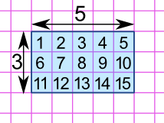
What is area?
Area is the term used to define the amount of space taken up by a 2D shape or surface.
We measure area in square units : cm² or m².
Area is calculated by multiplying the length of a shape by its width.

Slide 7
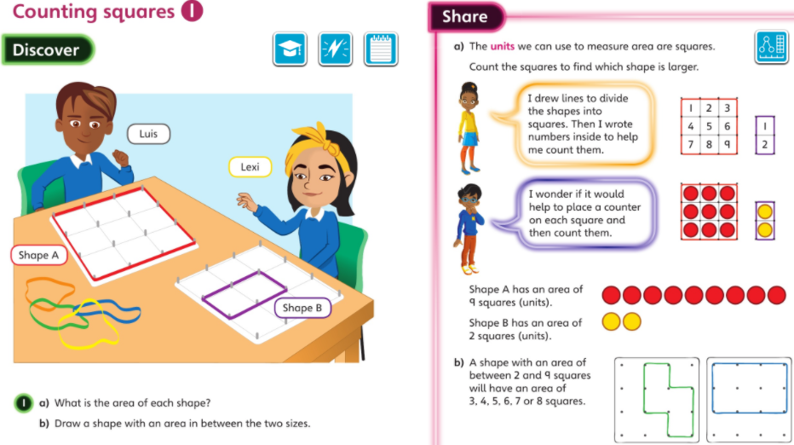

Slide 8
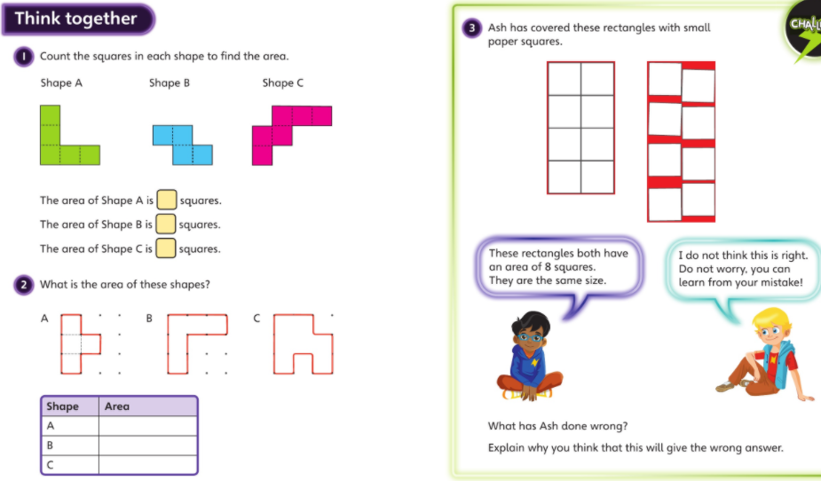

Slide 9
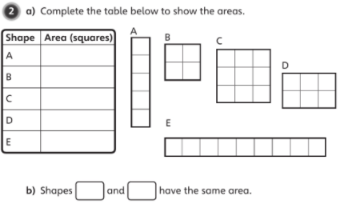
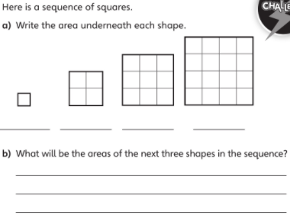
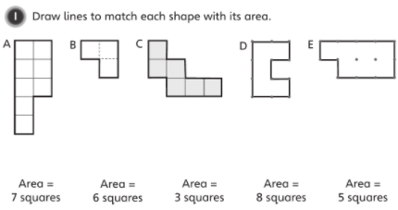
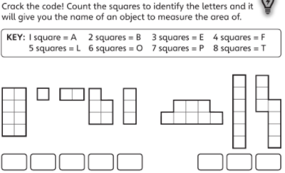

Start with the red challenge and then move through the challenges as you finish the previous one.

Slide 10
English
LI: To investigate calligrams

Slide 11

English
Our new unit of English is calligrams and shape poems. Before we show you what these are, have a look at the word below.
What do you notice about this word?
Why do you think the poet has chosen to write the word like this?
Words like this are called ‘calligrams’ and can be used to add effects in poetry.

Slide 12
Calligrams
A calligram is a poem, phrase, or word in which the typeface, calligraphy or handwriting is arranged in a way that creates a visual image. The image created by the words expresses visually what the word, or words, say. In a poem, it manifests visually the theme presented by the text of the poem.

Slide 13
Calligrams
Have you ever heard of calligram before?
Why do you think it would have been called shape poetry?
The calligram style of poem was written before then.
It was called "shaped poetry" or "pattern poetry”.
In 1918 French poet Guillaume Apollinaire published a book of poems that did not look like poems.
He named the book Calligrammes which means "beautiful writing".
He used words and lines to form his poems. Sometimes the shape related to the subject of the poem.
What effect do you think a shape poem would have on the reader?

Slide 14
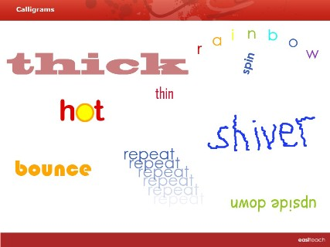
Here are some examples of calligrams
Which do you like best? Why?

Slide 15
Waves of sea water

Slide 16
Fat could be the word fat looking fat!
FAT

Slide 17
Or thin looking thin!
thin

Slide 18
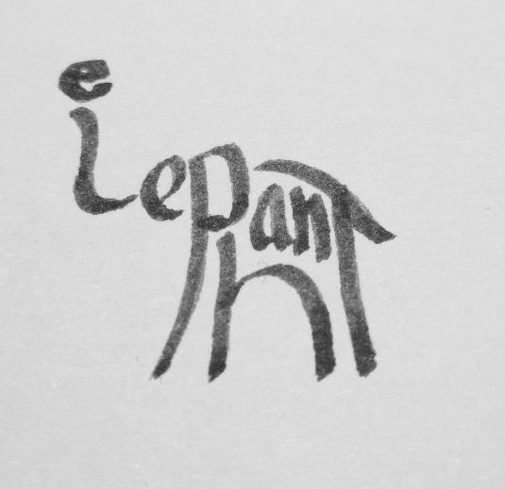
What animal is it?

Slide 19

Which words can you read?

Slide 20
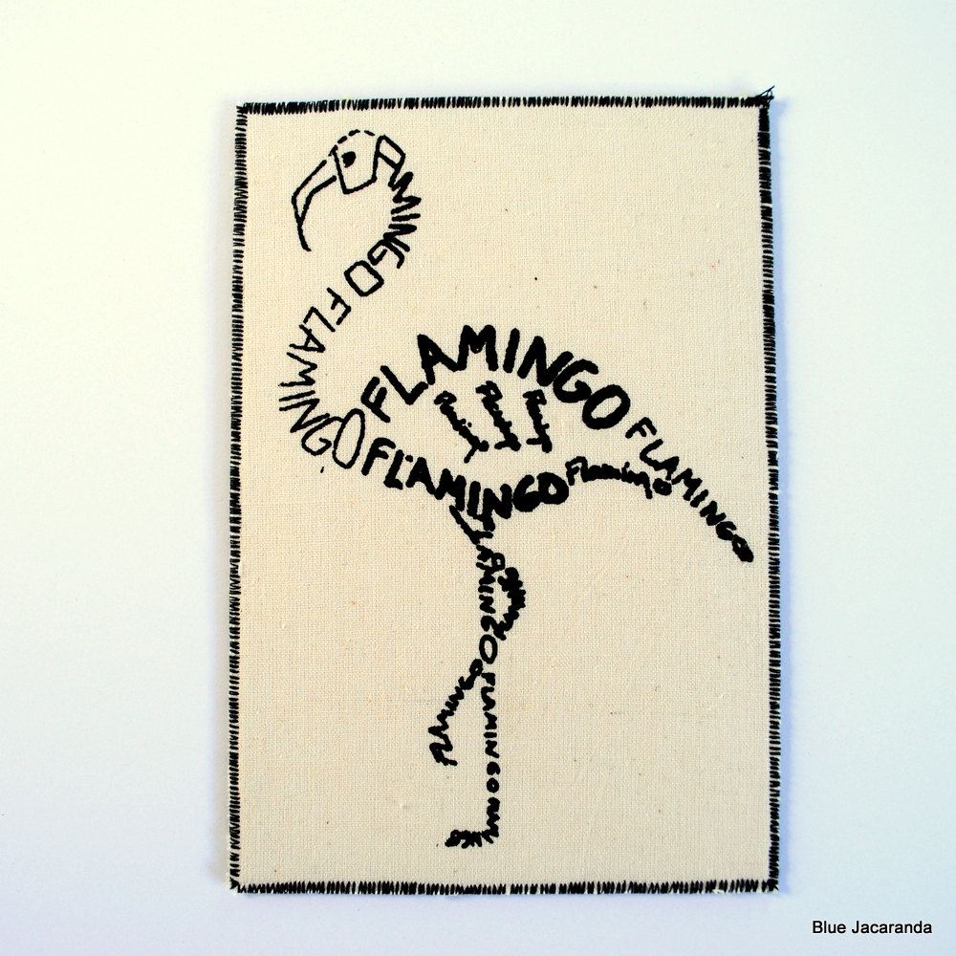
How many times has the author written flamingo?

Slide 21


Slide 22
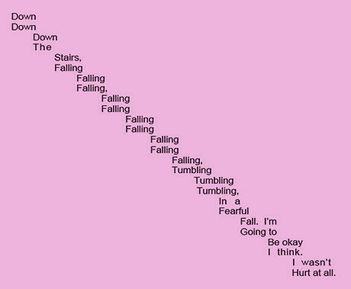

Slide 23

Which letters have fins?

Slide 24
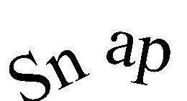
What’s happened to this word?

Slide 25
Now can you make your own calligram?
Here are some words you could try:-
Hot, cold, falling, snow, jump, sad, happy, leaf, alligator, smile ...............
Remember you can change one letter at a time or the whole word.

Slide 26
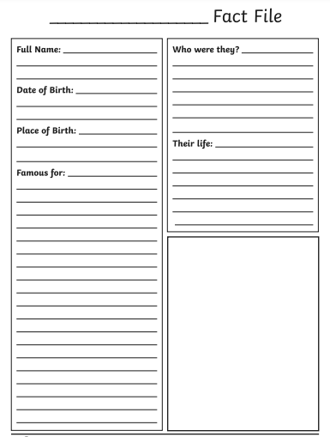
Art
Today, you will be looking at the famous artist Georgia O’Keeffe.
Work through the PowerPoint, reading the information about Georgia. Have a look at the examples of her work. Do you like them? Why?
Create a fact file about Georgia O’Keeffe.
When you have done this, have a go a creating your own piece of art in her style.

Slide 28
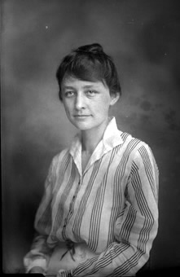
Early Life
Georgia Totto O’Keeffe was born on 15th November 1887 in Wisconsin, USA.
She was one of seven children, and her mother encouraged Georgia’s interest in art.
The landscape in Wisconsin was very important to Georgia, which became evident in her later work.
She studied at the Art Institute of Chicago and had her first gallery show in 1916.

Slide 29
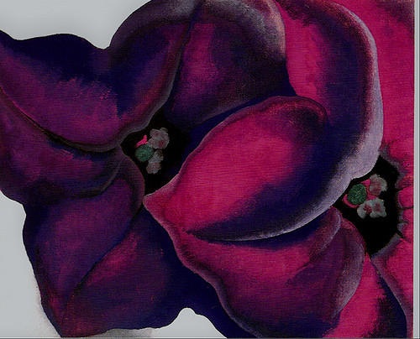
Flowers
Georgia began experimenting with painting close up views of flowers. She used oil paints in vibrant, bold colours.
Photo courtesy of koiart71 (@flickr.com) - granted under creative commons licence – attribution

Slide 30
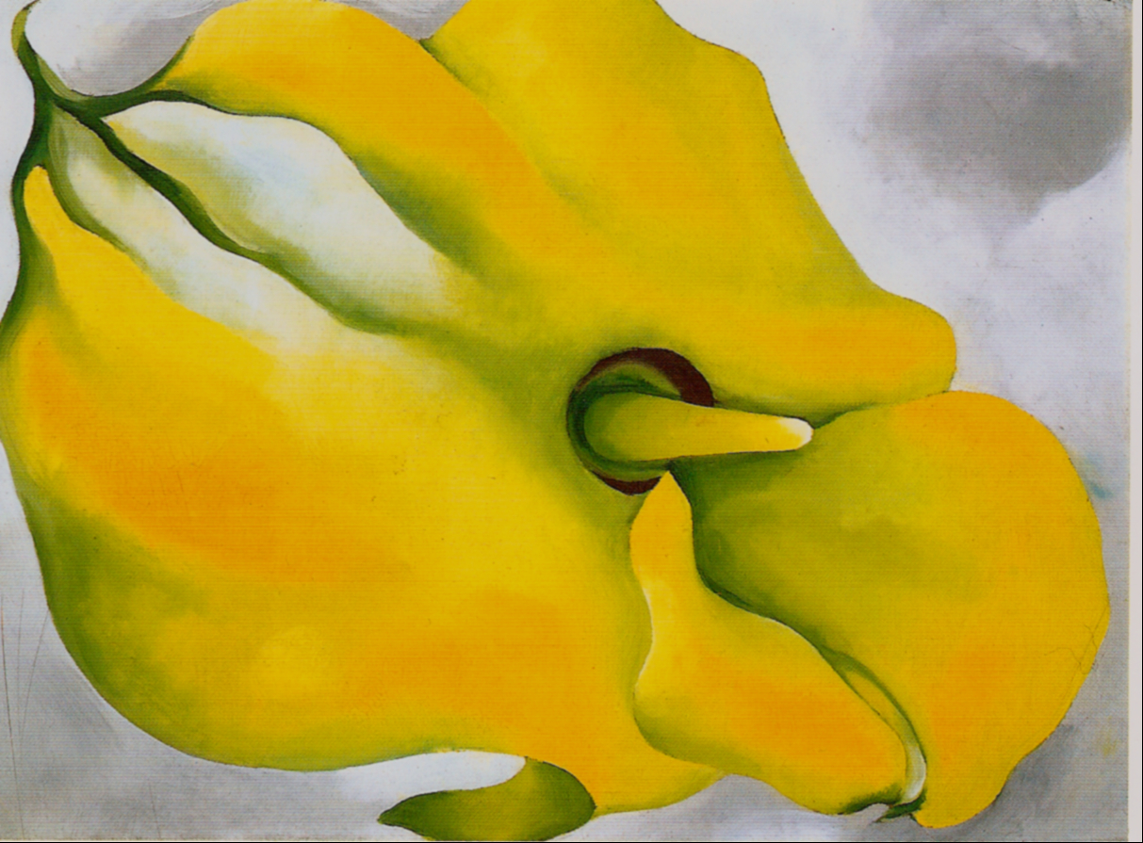
Yellow Calla
Photo courtesy of koiart71 (@flickr.com) - granted under creative commons licence – attribution

Slide 31
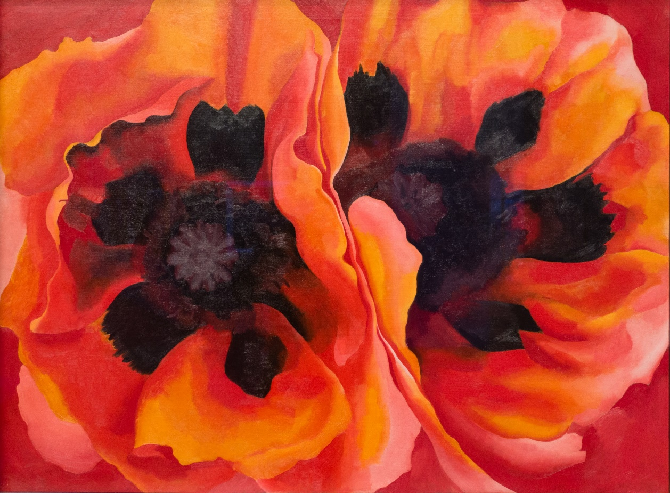
Oriental Poppies
Painting the flowers at such a close range makes the viewer see the object in a completely different way.
Photo courtesy of Sharon Mollerus (@flickr.com) - granted under creative commons licence – attribution

Slide 32

Inside Red Canna
The vibrancy of colour used, and the simplified images of leaves and petals, resulted in dramatic and innovative paintings, exploring the idea of abstraction.

Slide 33
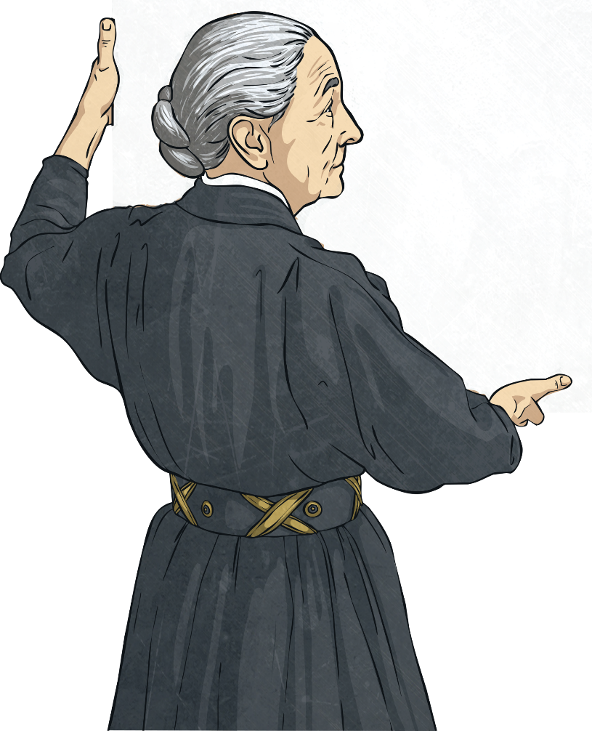
O’Keeffe’s Intention
"If I could paint the flower exactly as I see it no one
would see what I see because I would paint it small
like the flower is small. So I said to myself - I'll paint what I see - what the flower is to me but I'll paint it big
and they will be surprised into taking time to look
at it – I will make even busy New Yorkers take
time to see what I see of flowers."

Slide 34
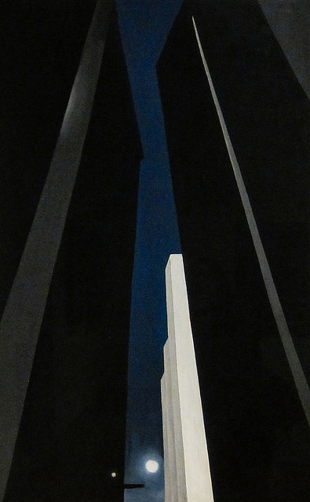
A Symbol of Modernity
O’Keefe began to look around during her time living in New York City, and began painting the skyscrapers.
Photo courtesy of Sharon Mollerus (@flickr.com) - granted under creative commons licence – attribution

Slide 35
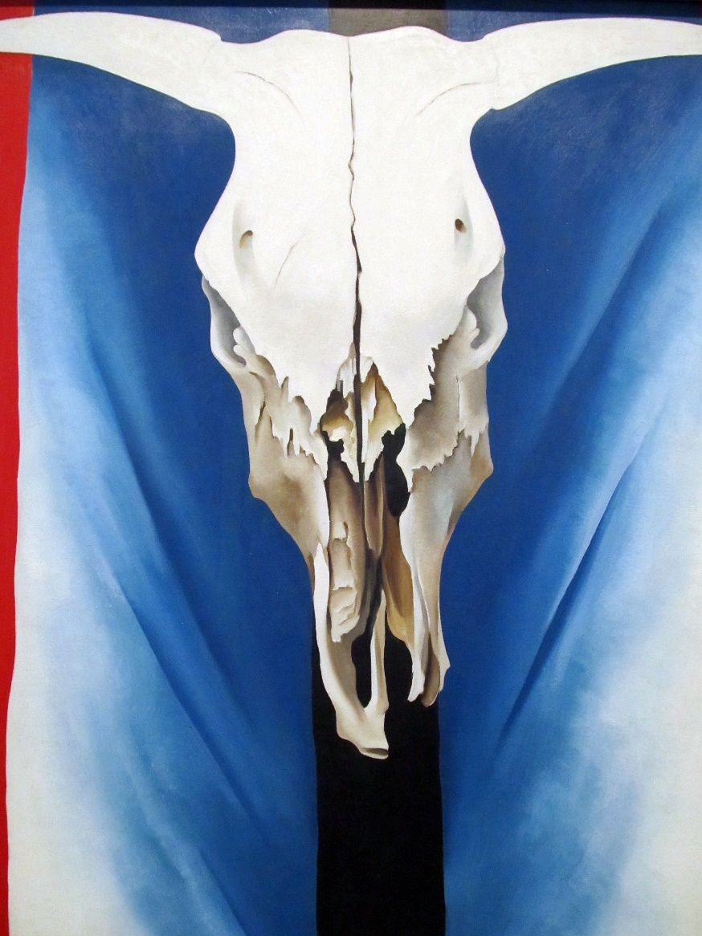
New Mexico
In 1929, O’Keeffe visited New Mexico and was amazed at the landscape; the incredible rock formations, the unusual light, the bones of animals dried out by the sun and the Navajo culture.
Photo courtesy of daryl_mitchell (@flickr.com) - granted under creative commons licence – attribution

Slide 36
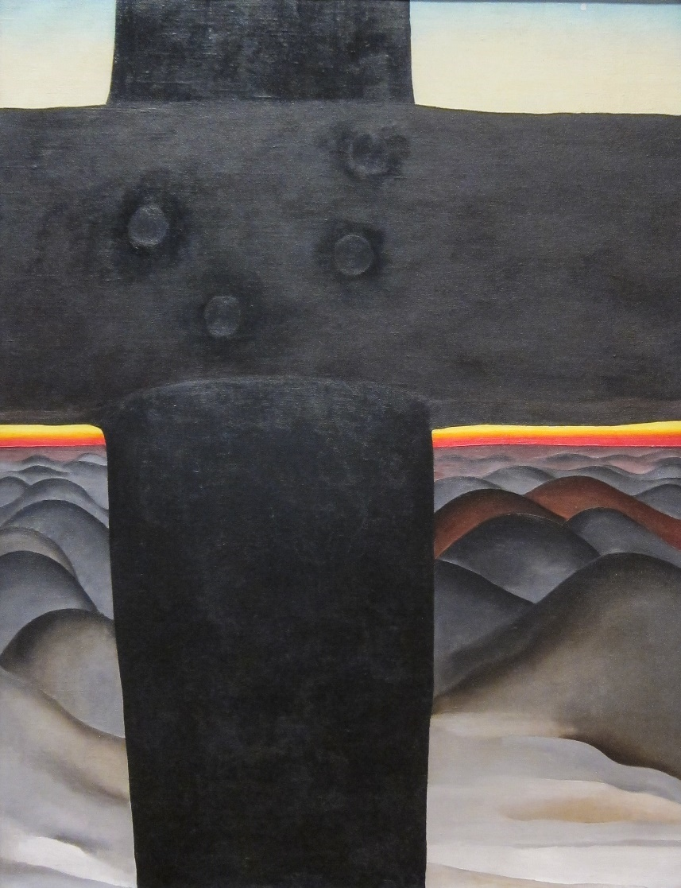
Black Cross
Photo courtesy of Sharon Mollerus (@flickr.com) - granted under creative commons licence – attribution

Slide 37
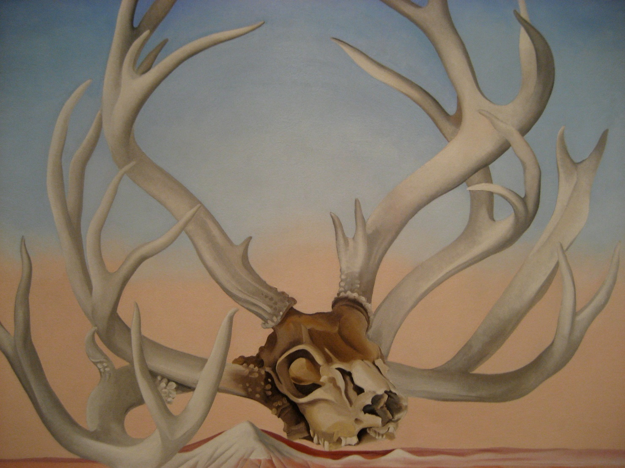
From the Faraway
Photo courtesy of missvancamp (@flickr.com) - granted under creative commons licence – attribution

Slide 38
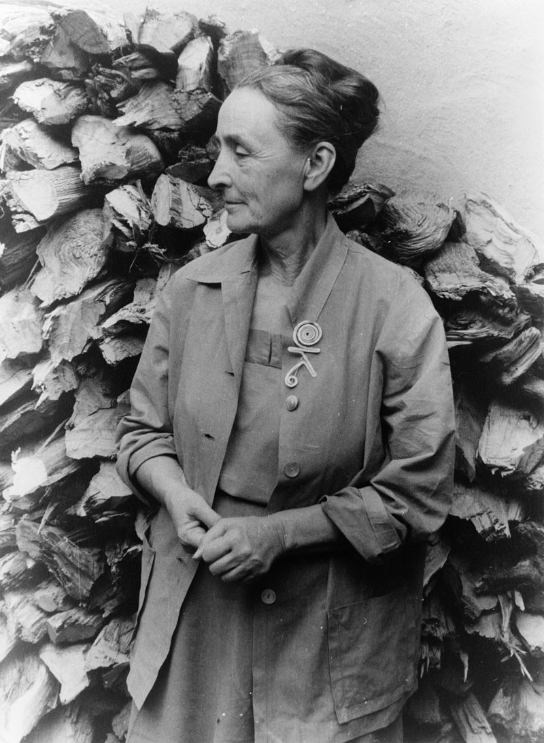
Later Life
Georgia O’Keeffe began to lose her eyesight and in 1972, she painted her last unassisted painting. She wrote a book
and in 1977, at 90 years old, said;
“I can see what I want to paint. The
thing that makes you want to create
is still there.”

Slide 39
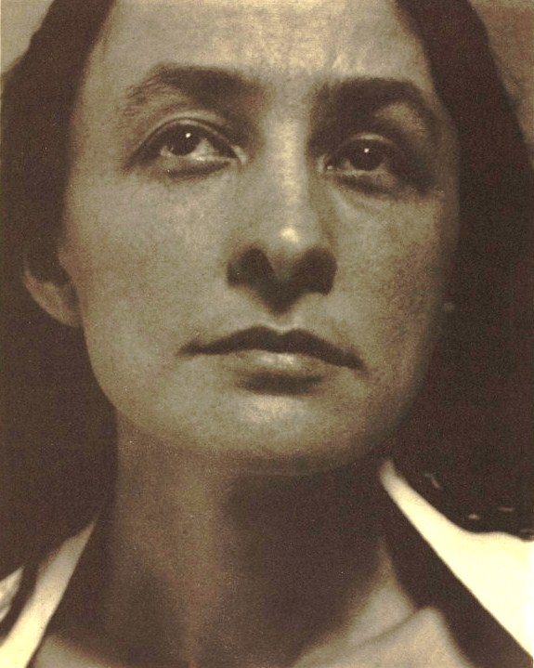
Legacy
Georgia O’Keeffe is recognised as being a pioneer of American modernism. She was highly praised for her art, which was unusual for a woman in a male dominated art world. She died on 6th March, 1986 aged 98 years old.
She painted thousands of painting, and The Georgia O'Keeffe Museum opened in Santa Fe in 1997.

Slide 40
Tuesday 23rd February 2021
Good Morning Enid Blyton and Jaqueline Wilson Class
9.30-10.30
Reading
11.00-12.00
Maths
1.00-2.00
English

Slide 41
Reading/Writing
LI: To establish a surface understanding of the story
Today, you will be hearing the story read out loud for the first time up to page 20. Try not to ask questions whilst it is being read, you will have an opportunity to talk about this soon.

Slide 42
Reading/Writing
LI: To establish a surface understanding of the story
Now I will read it again, this time you can put your hands up to tell us things that you have noticed as its being read. I will also ask you some questions!
Why do you think Annabelle keeps knitting?
Why does Luke make fun of Annabelle and Mars?
Why does Annabelle knit a hat for Mr Crabtree?
Does Annabelle only knit for people and animals?
How do you think things have changed in the town?
Will Annabelle keep knitting?
Will she run out of yarn?
What if she runs out of things to knit jumpers for?
Notes:
Why do you think Annabelle keeps knitting? (Answers could refer to the literal, fact that the yarn does not ever run out, but they could also show a deeper level of understanding and refer to the way that the jumpers are making everyone happier and feel closer.)
Why does Luke make fun of Annabelle and Mars? (This can be answered by re-reading the text where Annabelle tells him he is jealous of her.)
Why does Annabelle knit a hat for Mr Crabtree? (Answers can demonstrate literal understanding if referring to the fact that Mr Crabtree doesn’t wear jumpers and he says he doesn’t want one.)
Does Annabelle only knit for people and animals? (This requires a literal response. No – the text says she makes jumpers for things that didn’t even wear jumpers and the illustration shows the buildings and trees wearing them.)
How do you think things have changed in the town?

Slide 43
Final Reflection
You may have noticed that there are four sentences that begin, ‘But…’
I will read them again, can you join in with me when we read the word ‘But’.
I wonder why the sentences start this way?
What do you think?

Slide 44
Maths
L.I. – To investigate area (2)

Slide 45
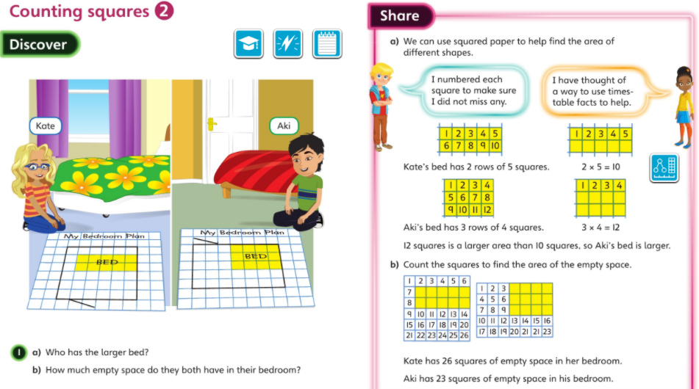

Slide 46
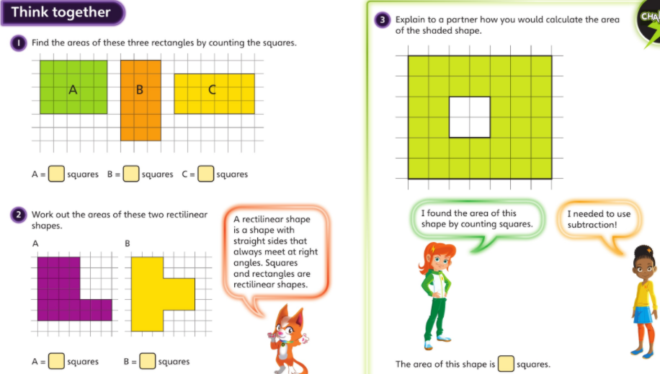

Slide 47
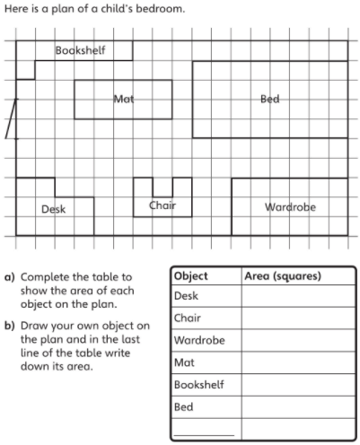
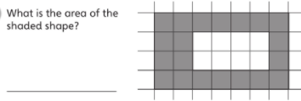
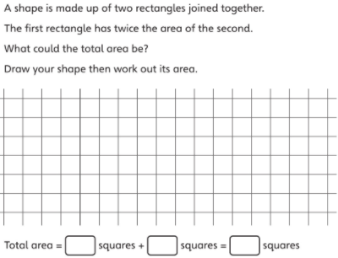
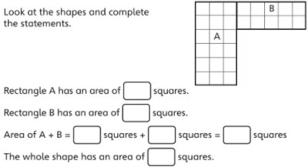
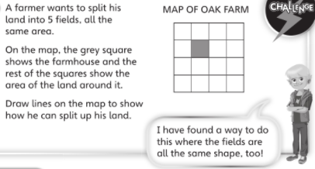
Start with the red challenge and then move through the challenges as you finish the previous one.

Slide 48
English
LI: To investigate shape poems
What do you think a shape poem is?
A shape poem is a poem that describes an object and is written in the shape of the object.

Slide 49
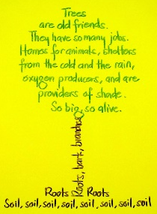
What do you notice about the way the author has written this?
I think it is like a … because…

Slide 50

Time to tone up those poetry muscles;
let’s get in shape!
An informative PowerPoint about identifying the features of limericks

Slide 51
Calligram Examples
Calligrams, or shape poems, represent the topic of the poem in their shape.
Have a look at these two calligrams.
It’s
cold outside.
I don’t want to go
Shines
outdoors and play.
bright
But mum says
I have to
above.
in the
anyway
It’s starting to snow
Star
winks
darkness
brrr…
and I’m going to freeze –
brrr….
I hate playing outside on days like these.
brrr….
But wait a sec, I’ve had the
brrr….
most amazing, brilliant idea!
and
of the
I’ll cover myself up
with snow and I’ll
night
twinkles
hide in here!
‘Snowman’
by Kenn Nesbitt

Slide 52
Shape Poem Features
What did you notice?
Think about:
the position of the words or phrases
any colours the poet has used
the shape the poem makes
Shape poems are often written as ‘free’ verse
– they don’t have to rhyme!
Some shape poems (like ‘The Snowman’) are written inside a very light outline of a shape. The words have to be different sizes to fill the shape up just right!
Other shape poems (like ‘Star’) follow the outline of a shape, so the words make the edges.

Slide 53



Your Turn!
Have a look at these poems. How could you make one into a brilliant shape poem?
Standing under the bridge
The river ripples beside me
I shiver and look out
At the pouring rain.
My teddy is my best friend
His fat tummy is made
For hugging when I ’m happy or sad.
His big ears listen to my secrets
Soft paws, fluffy fur, bright eyes
I think he knows
Everything about me!
Falling leaves
Swaying, fluttering
Rustling under foot
Drifting into piles
Like autumnal snow
I miss the green leaves
When will it be spring again?

Slide 54
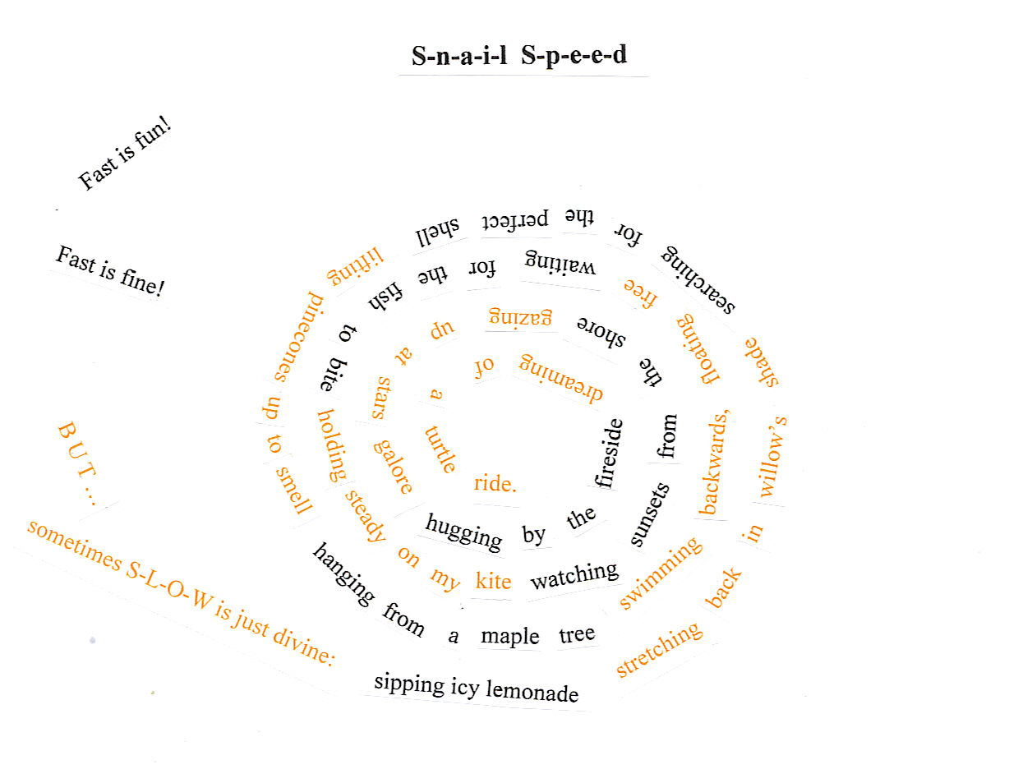
Could you write your own shape poem?

Slide 55
Plenary
What have we learned about Shape poems?
Shape poems don’t have to rhyme.
They form a shape which represents the topic of the poem.
Sometimes they are written inside a shape.
Sometimes the words themselves form the outside edges of a shape.
Words and phrases can be stretched, squashed or distorted to show their meaning.

Slide 56
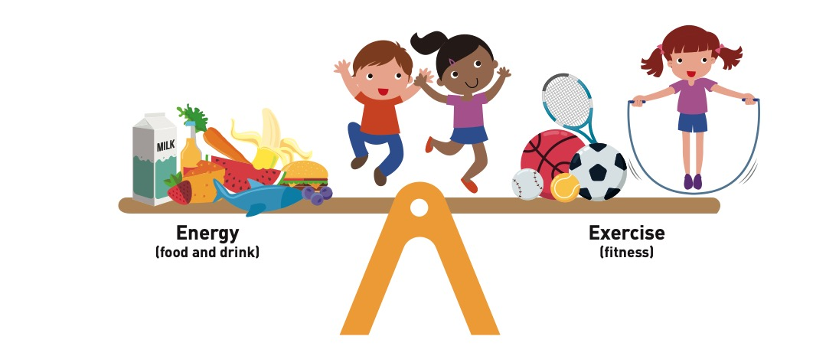
PHSE
LI: understand how exercise affects my body and know why my heart and lungs are such important organs
What do you think this picture is showing/
telling us?

Slide 57
PHSE
Our bodies need energy to work, grow and exercise; and that energy comes from food and drink (calories or kilojoules).
Our bodies also need to exercise to stay healthy. Our bodies are ‘in balance’ (healthy) when we take in the right amount of energy and do the right amount of activity to use it.
So the see-saw would be balanced.
Have a think about these questions and write down your answers.
What might happen if a person took in too much energy and didn’t exercise enough?
Would the see-saw tip one way?
How could a person’s health be affected?
How about if a person exercised too much but didn’t take in enough energy?
What would happen to the see-saw then?
How could a person’s health be affected?
Can a person put their ‘see-saw’ back into balance if they have tipped one way or another? How could they do this?

Slide 58
PHSE
Children needing to be active for an hour a day is a minimum and you can always do more.
The hour can be made up of lots of different chunks of time and activities throughout the day.
You can choose what activities you do in order to keep their bodies healthy.
Everyone is going to make up their own fitness challenge: everyone’s fitness challenge will be different and will be unique to each person because our bodies are individual.

Slide 59
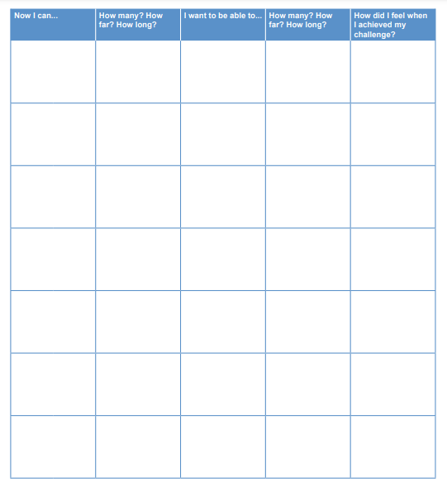
PHSE
On the left is a fitness challenge template.
Think about something thing you can do now without stopping for a break, for example play football for half an hour, skip with a rope for 10 minutes, do jumping jacks for 2 minutes, hop on the spot 20 times, run really fast between two points, etc.
You can draw or write what you can do now and how many you can do or for how long/how far, in the first row of the template.
Then think about how you can challenge yourself.
Your challenges need to be realistic and manageable.
Draw or write in the second row of the template what you would like to be able to do and how many/how far/for how long, for example, skip with a rope for 15 minutes without stopping, hop on the spot 30 times, etc.
Be creative with your ideas.
The other rows in the template are left blank for now, so that when you achieve their challenge, they can add a new one underneath to keep getting fitter.

Slide 60
Wednesday 24th February 2021
Good Morning Enid Blyton and Jaqueline Wilson Class
9.30-10.30
Reading
11.00-12.00
Maths
1.00-2.00
English

Slide 61
Reading/Writing
LI: To develop inference and questioning skills
Read to the page (21-22) where the archduke first appears, without sharing the illustration of the archduke. Re-read the sentence:
‘One day an archduke, who was very fond of clothes, sailed across the sea and demanded to see Annabelle.’
I have here the illustration of the archduke and I would like you to draw him as I describe him.
Lets share our illustrations and you can share how it relates to the text that we have read and have a look at the illustration from the book.
Are they similar?

Slide 62
Reading/ Writing
For your activity, you will be recording different observations and ideas.
The assignment will have the headings ‘I know’, ‘I think’, and ‘I want to know’.
First, let’s share with each other what we know about the archduke.
Look for visual clues as well as textual clues. And don’t forget to identify where you found the information!
Add your ideas to the assignment under ‘I know’.
Then, let’s look at what we can infer. We will record this under ‘I think’.
Inferring is not what we know for sure but what we think based on the clues that the text gives us.
For example, you might say that the archduke is used to people doing as he asks because he demands to see Annabelle.
You might also say he is rich because he has his own boat.
We often use because to indicate that we are justifying our ideas and providing evidence for them.

Slide 63
Reading/ Writing
Now, let’s think about what the author doesn’t tell us.
Can you think of some things that you would still like to know?
For example:
  Why has the archduke come to visit?
  What will he say to Annabelle?
  Does he want a jumper knitted for him?
  Add your questions onto your assignment under the heading ‘I want to know’.
Final reflection
Let’s share some of our questions as a class and I would like to see if some children will have a go at predicting what they think the answers would be using their inference skills!

Slide 64
Maths
L.I. – To compare area

Slide 65
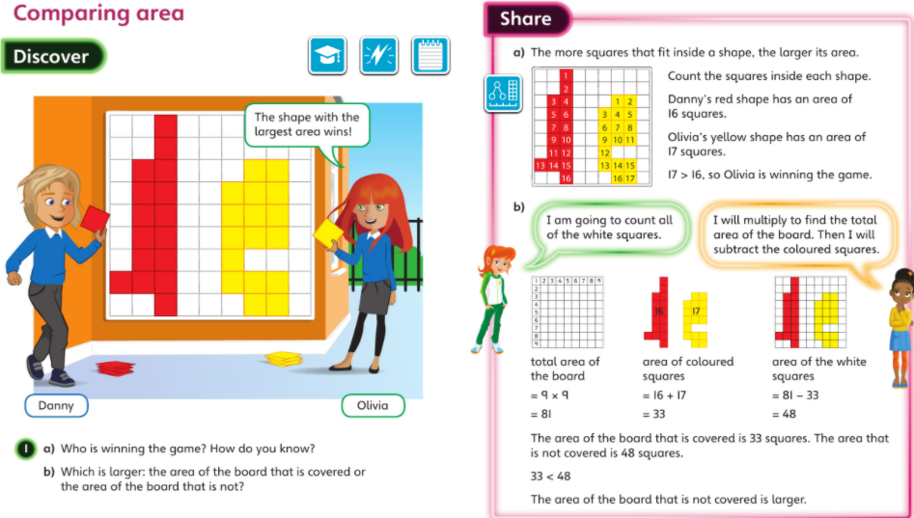

Slide 66
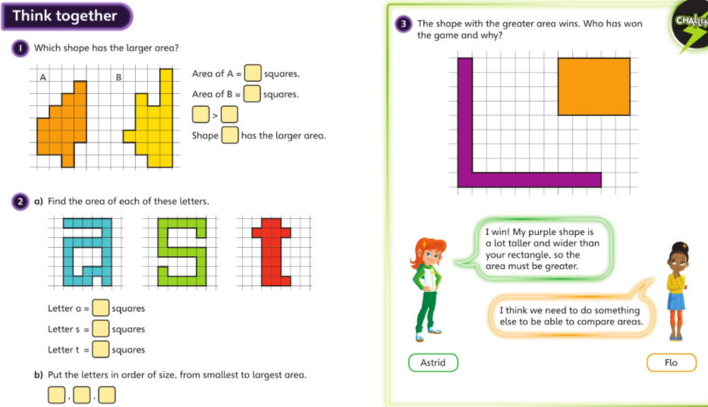

Slide 67
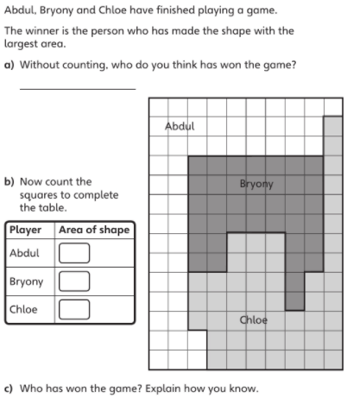
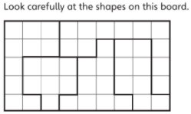
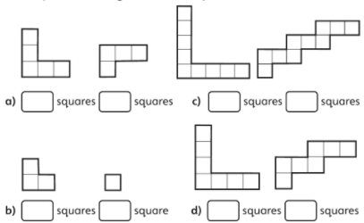
Start with the red challenge and then move through the challenges as you finish the previous one.
Write the area of each shape in the pairs and then use the symbols <,> or = to compare them.
Is it always, sometimes or never true that taller, wider shapes have a greater area than shorter, narrower shapes?
Draw some shapes on a blank piece of paper to try out your ideas
C
A
E
B
D
Which shape has the smallest area?
What shape has the greatest area?
What is the total area of the shapes on this board?

Slide 68
English
LI: To investigate and analyse the effectiveness of calligrams and shape poems

Slide 69
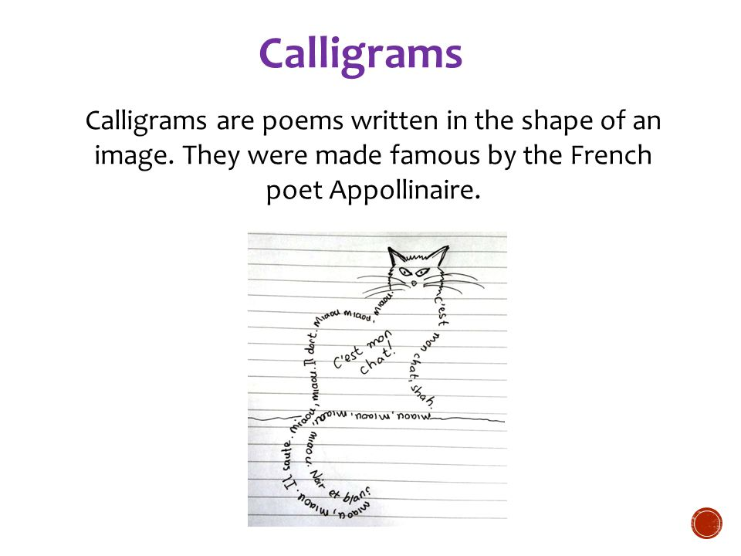


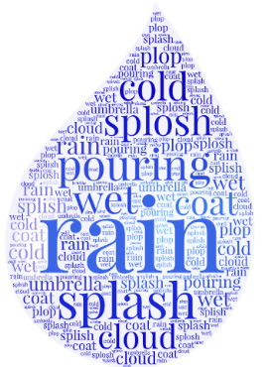
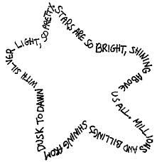
Which poem do you think is most effective? Why?
Notes:
What is good about these calligrams and shape poems? Why?

Slide 70

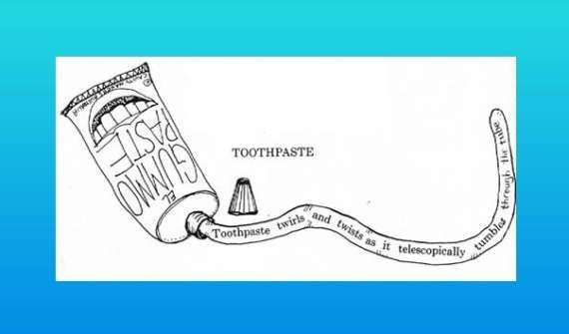


If you could write a shape poem about anything, what would you choose and what would it look like?
Which poem is your favourite and why?

Slide 71
English
Investigate the effectiveness of a range of calligrams and shape poems.
Explain what you like about each of the calligrams and shape poems.
Tell me about the interesting vocabulary the poet used?
Explain what you like about the calligrams and the shape poems.
What interesting vocabulary did the poet use?
Tell me about the exciting adjectives and adventurous verbs used.
Explain what you like about the calligrams and the shape poems.
What interesting vocabulary did the poet use?
Tell me about the exciting adjectives and adventurous verbs used.
Did you spot any similes? What effect did these have?
What could you improve? How?
Explain what you liked using the key questions below.
What interesting vocabulary did the poet use?
Tell me about the exciting adjectives and adventurous verbs used.
Did you spot any similes? What effect did these have?
Could you change any words into calligrams?
What effect would this have?

Slide 72
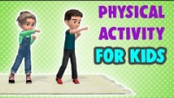
PE
https://youtu.be/3_oIssULEk0
Complete the workout in the video. Challenge yourself to keep up with the characters on the screen.

Slide 73
Thursday 25th February 2021
Good Morning Enid Blyton and Jaqueline Wilson Class
9.30-10.30
Reading
11.00-12.00
Maths
1.00-2.00
English

Slide 74
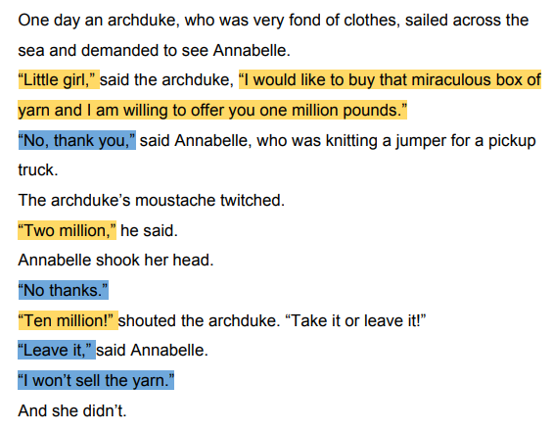
Reading/Writing
LI: To use readers’ theatre to develop reading fluency and confidence
First, we will read this passage out loud. Pay attention to my expression and phrasing.
Did you notice anything about the way that I read that?
How does the archduke feel when Annabelle refuses to sell the box?
Do his feelings change as he offers more money and she continues to refuse?
How does Annabelle feel? What clues are there in the illustrations and the text?

Slide 75
Reading/Writing
Now you will have some time to practise reading the script yourself.
Do not stop, read it over and over out loud. Pay attention to how words should be said, add expression.
When we have finished I would like some children to volunteer to have a go at being one of the characters and performing the script.

Slide 76
Reading/ Writing
Final reflection
Is there anything else the archduke could have said to persuade Annabelle?
Let’s have a look at the illustration on this page.
Think about these questions:
Did Readers Theatre help you understand how the archduke might be feeling?
Did it make you consider what he might do next?

Slide 77
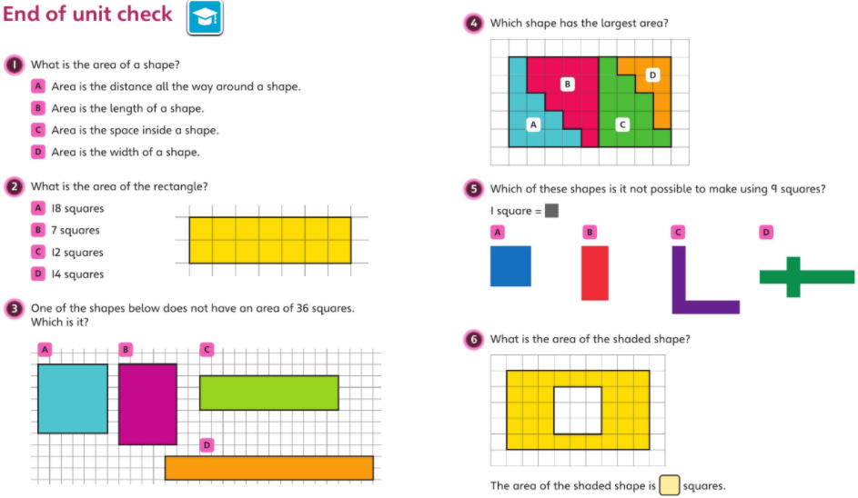
Maths
Starter

Slide 78
Maths
L.I. – To understand months and years

Slide 79
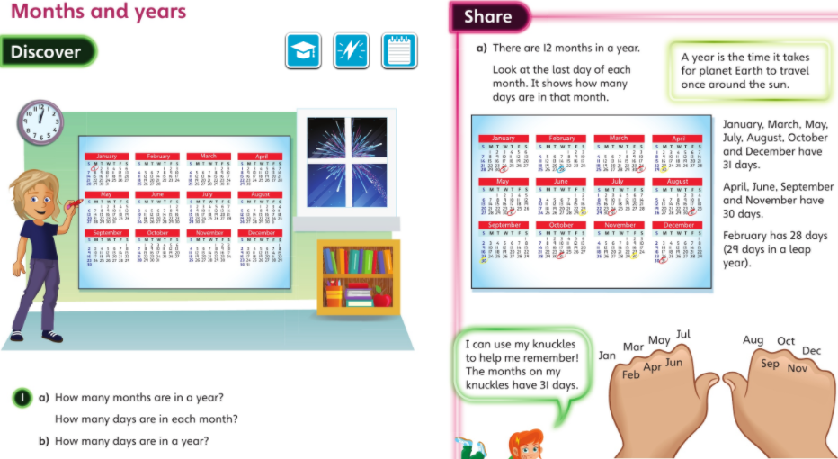

Slide 80
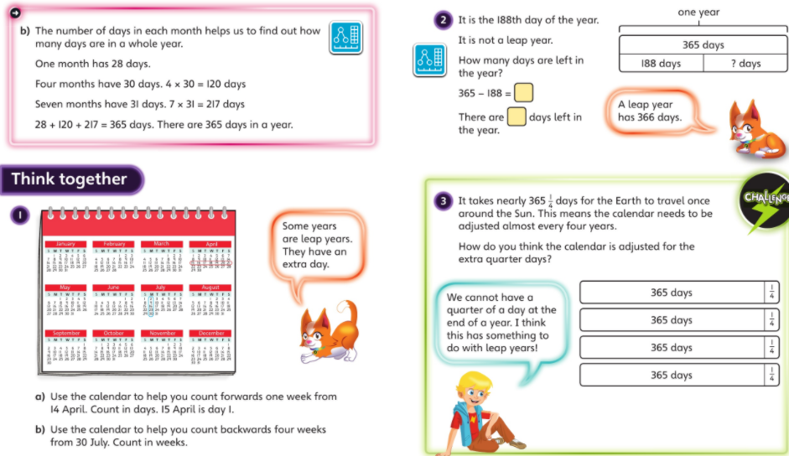

Slide 81







Start with the red challenge and then move through the challenges as you finish the previous one.
EXT:

Slide 82
English
LI: To collect ideas for a shape poem

Slide 83



Without reading the poems, what do you think they will be about? Why?
What are different about the structure of these two poems?

Slide 84


What can you tell me about the features of these poems?

Slide 85

Focus on: taste, touch, smell, sight and hearing.
Think about the adjectives that can be used to describe the apple.
What things will you need to think about when writing a shape poem about this fruit?
The shape, words, feelings?

Slide 86
English
Describe the fruits using the 5 senses (sight, sound, smell, touch and taste). Include at least one adjective to describe each sense.
Write an expanded noun phrase, using at least one adjective to describe 4 fruits. e.g. the red apple
a juicy pear
Choose two fruits and write a sentence to describe them using at least two adjectives for each, using a comma to separate them.
E.g. I can see a red, juicy apple.
Choose two different fruits and write a sentence to describe them using at least two adjectives for each, using a comma to separate them (expanded noun phrase). This time include two different senses for each fruit.
E.g. I can see a red, juicy apple and smell its delicious, sweetness.
Choose two different fruits and write a sentence to describe them using at least two adjectives for each, using a comma to separate them (expanded noun phrase). This time include two different senses for each fruit and include a preposition.
E.g. I can see a red, juicy apple and smell its delicious, sweetness from across the room.

Slide 87
Music
For your music lesson this week, we would like you to follow this link:
https://www.derbyshiremusichub.org.uk/get-involved/music-at-home/junior/6.aspx
All instructions are displayed on the page ☺

Slide 88
Friday 26th February 2021
Good Morning Enid Blyton and Jaqueline Wilson Class
9.30-10.30
Reading
11.00-12.00
Maths
1.00-2.00
English

Slide 89
Maths
L.I. – To calculate hours in a day

Slide 90


Slide 91


Slide 92






Start with the red challenge and then move through the challenges as you finish the previous one.
EXT:

Slide 93
English
LI: To understand and use similes

Slide 94

English https://www.youtube.com/watch?app=desktop&v=0YEKteMdPD8
Can you remind me again what a simile is?
Complete the similes that have been started for you on assignments.
Think about the food that you focused on yesterday – can you come up with some of your own similes for these foods?

Slide 95
Finish these simile starters:
The moon glowed like…
Snow fell from the sky like…
The icy made the ground as slippery as…
The fog covered the city like…
The clouds are as fluffy as…
The child sang as sweetly as…
The children scuttled across the beach like…
The air smells as fresh as…
The road wound its way up the mountain like…
Her angry words spewed out like…
The rain tapped on the roof as steadily as…
The traffic moved as slowly as
Now think about the fruits you focused on yesterday and have a go at writing as many of your own exciting similes for these fruits as you can. Use a range of similes including like and as.

Slide 96
Science – What plants need
LI: To explore the requirements of plants for life and growth
Places for Plants
What do you think plants need to grow?
Draw a rough picture of the best place to grow a plant, e.g. a garden, a greenhouse, etc and annotate your picture to show what that place has that you think the plants need.
Explain why you have chosen this place, e.g. I have chosen a greenhouse because it is warm and light.
Don’t spend too long on this but make sure you keep it safe for later learning. Over the next few weeks, we will be investigating what plants need to grow better and will refer back to our thinking to see if and how this changes.

Slide 97


Science – What plants need
Places for Plants
Read each statement and tick the box to show whether you think it is ‘true’, ‘false’ or ‘not sure’.

Slide 98

Science – What plants need
Places for Plants
Read each statement and tick the box to show whether you think it is ‘true’, ‘false’ or ‘not sure’.

Slide 99

Science – What plants need
Places for Plants
Read each statement and tick the box to show whether you think it is ‘true’, ‘false’ or ‘not sure’.

Slide 100

Topic
LI: To develop chronological awareness
Have a look at the video below for a reminder of what chronology is.
So we know that chronology is the ordering of dates or events in the order that they happened.
First think about all the important things such as when you were born, when you started walking, started school, or had a brother or sister. Have a discussion with an adult about this.
Now, have a go at putting these events onto a timeline.

Slide 101

The name, which was first recorded in 1438 in the form Clakyngewyk. | During the North Sea flood of 1953, Jaywick was flooded, resulting in the deaths of 35 people. | The Jaywick Miniature Railway operated in Jaywick from 1936. | In 1978, the local council began to control housing development in Jaywick. | A sea wall was built in 1880 to protect against flooding.
Jaywick was a popular holiday destination from 1930. | It became known as Gey wyck in 1584. | During the North Sea flood of 1953, Jaywick was flooded, resulting in the deaths of 35 people. | Jaywick was proposed by property developer Frank Stedman in 1928 as a cheap holiday retreat for Londoners. | A mains sewer system was installed in 1977.
Above, are ten different events that have happened in Jaywick over time. The events are not in order. Your activity will be to create a chronological timeline of these events.
Make sure you look carefully at the dates when arranging them in order.
EXT: Are there any events that you can add to this timeline? Ask other members of your household if they know any.

