Slide 1
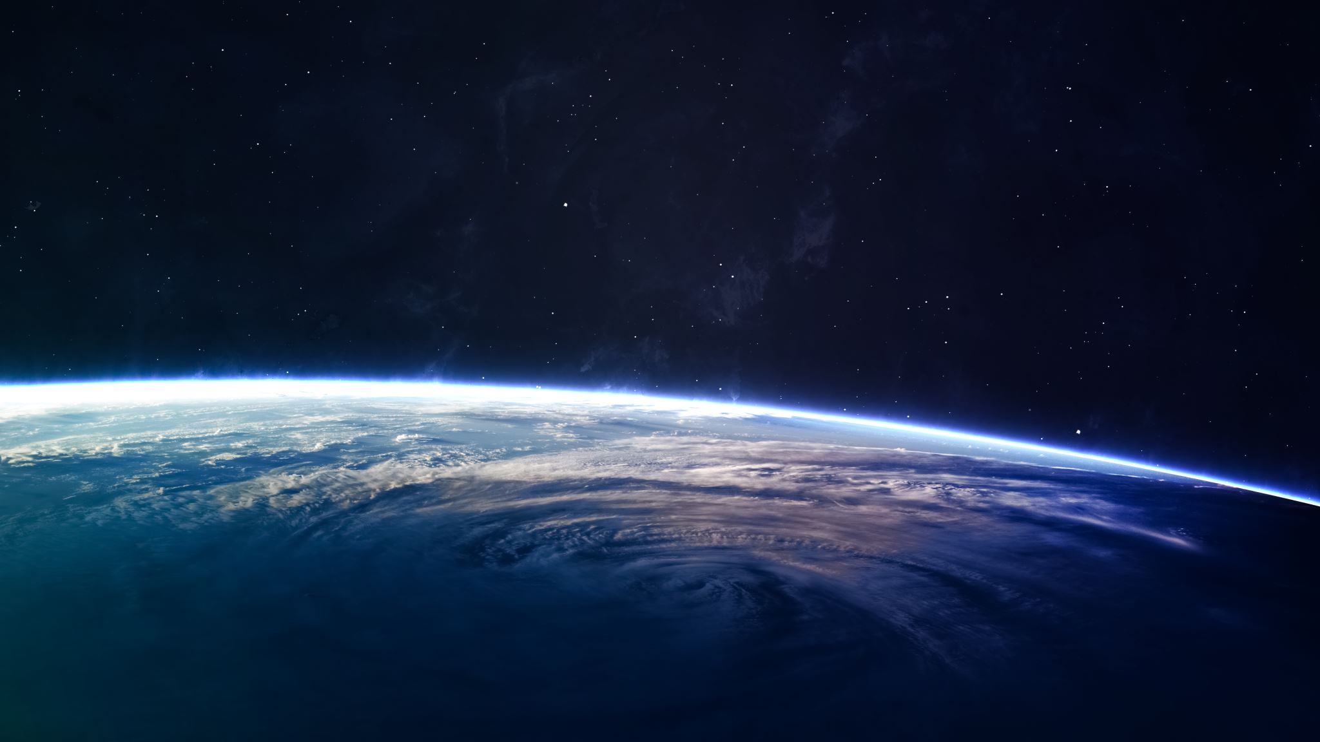
Space and the planets

Slide 3
The Sun

Slide 4
Mercury

Slide 5
Venus

Slide 6
Earth with the moon in orbit

Slide 7
The moon

Slide 9
Mars

Slide 10
Jupiter with icy moon Europa

Slide 11
Saturn

Slide 12
Uranus

Slide 13
Neptune

Slide 14
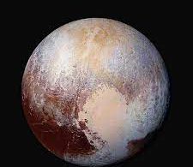
Pluto
This is no longer classed as a MAIN PLANET but is a dwarf planet because it size is too small.

Slide 15
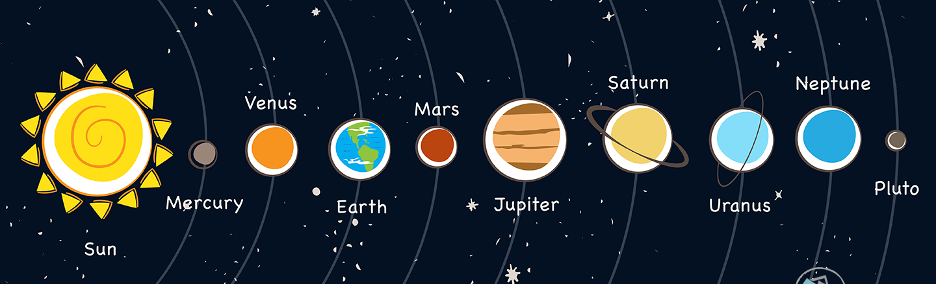

Slide 16
Thursday 11th February 2021

Slide 17
Earth
What is Earth?

Slide 18
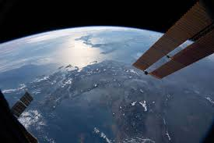
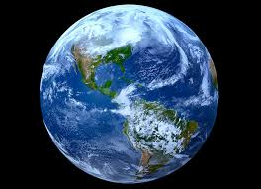
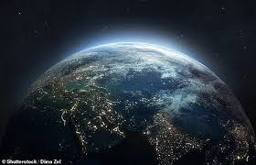
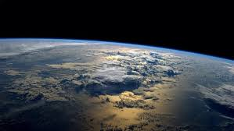

Slide 19
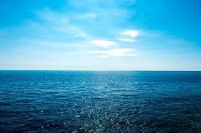
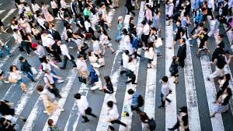
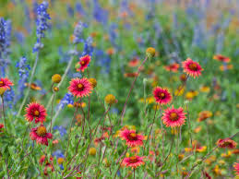
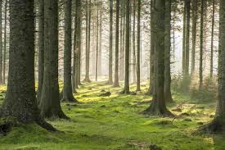
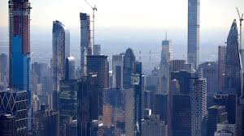
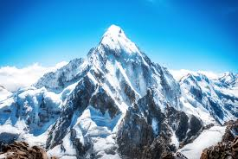
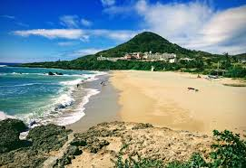
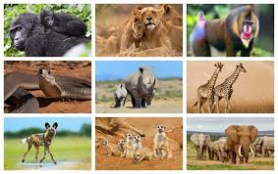
What is on planet Earth?

Slide 20
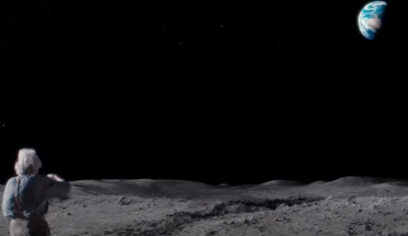
What can he see?

Slide 21
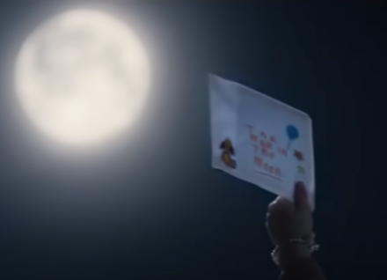
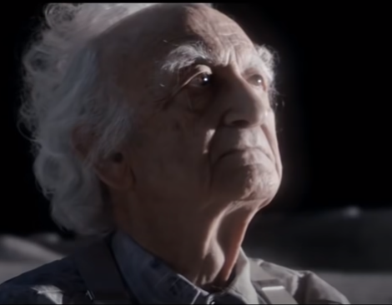
Write a letter to the
Man on the Moon.
Remember:
Say who the letter is for.
Decide three things you would like to tell him about Earth.
Say who the letter is from.

Slide 22
Friday 12th February 2021

Slide 23
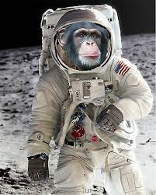
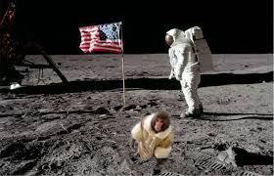
What if…
A monkey landed on the moon?

Slide 24
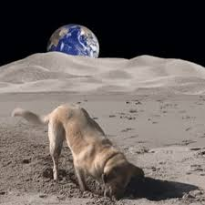
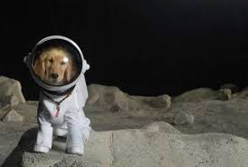
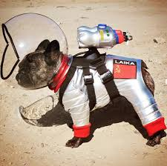
What if….
A dog went to the moon?

Slide 25
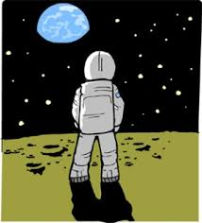
A human went to the moon?

Slide 26
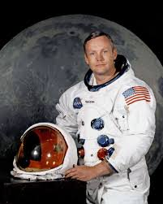
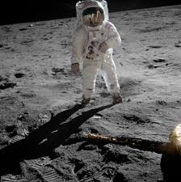
Neil Armstrong was the first human
to walk on the moon on 20th July 1969.

Slide 27
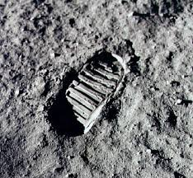
Watch the journey to the moon and
the first steps.

Slide 28
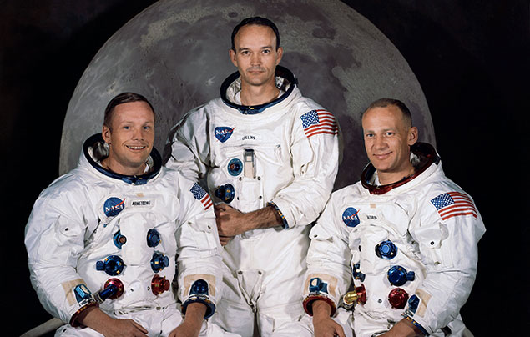
The Apollo 11 crew
Neil Armstrong
Michael Collins
Edwin ‘Buzz’ Aldrin

Slide 29
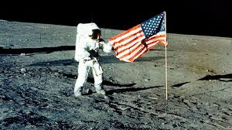
A flag was left on the moon.

Slide 30
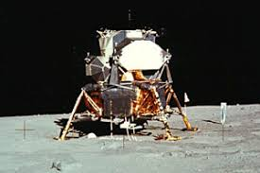
When they landed on the moon
there was only 30 seconds of fuel left.
Count to 30 to see how short it is.

Slide 31
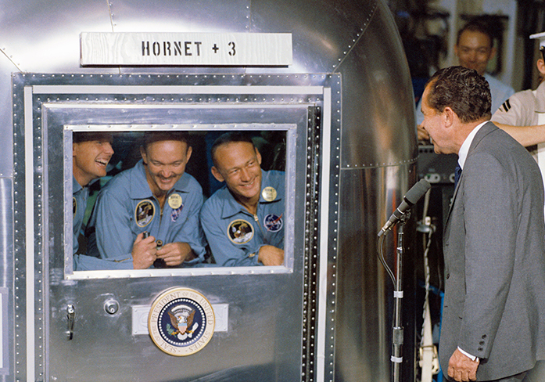
What do you think
the astronauts took
with them to space?

Slide 32
What would you
take to the moon?

